Slide 1

Data Stream
Thuc Le
Advanced Analytic Techniques 2
University of South Australia

Slide 2

Outline
Bloom Filter Sketch
Hash Sketch (FM sketch)

Slide 3

Bloom filter
Problem: Given a large set S, check whether a new element i is in the set
Check if an IP address is in the black list
Check a login if this is an existing account
Example: S=
Check if 10 in S? Is 20 in S?
Sampling and windowing may not work well
3 | 6 | 0 | 7 | 10 | 19 | 23 | 37

Slide 4

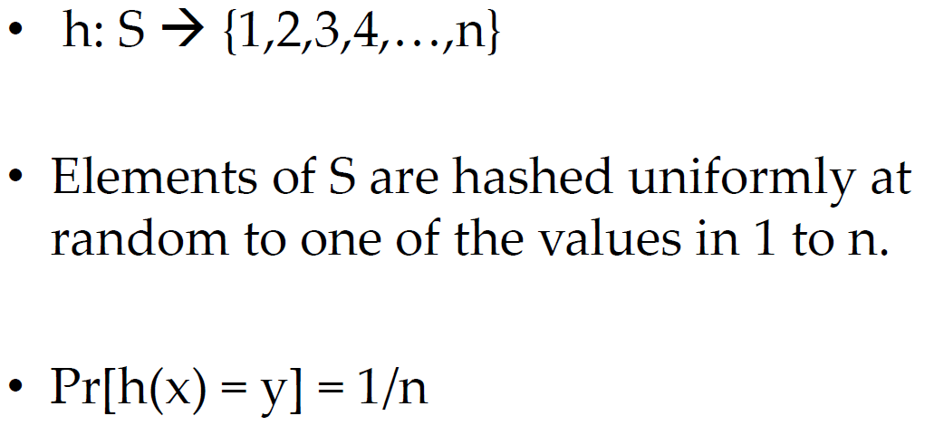
Primitive: Hash function
Alvin
Simon
Theodore
Alvin
…
1 | 2 | 3 | 4 | 5 | 6 | 7 | 8

Slide 5

Bloom filter
Input: S has m elements from a data stream, memory size n, m>n
Output: Returns TRUE → there is a high chance that the element is in S
Returns FALSE → when the element is not in S

Slide 6

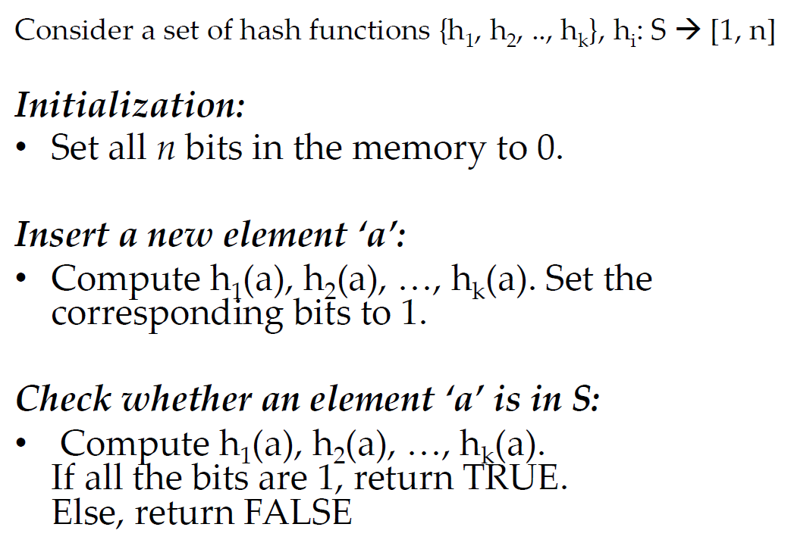
Bloom filter

Slide 7
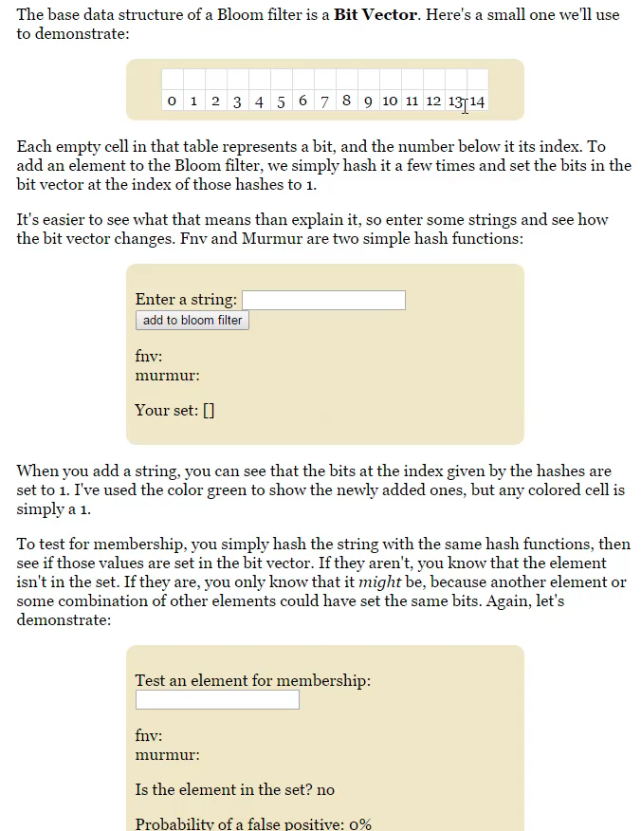

Slide 8

Bloom filter

Slide 9

Bloom filter
Given a large set of element S, efficiently check whether a new element is in the set
Bloom filters use hash functions to check membership
Return TRUE if there is high probability of the element is in S
Return FALSE if the element is not in S
False positive error rate depends on the size of S and the size of the memory

Slide 10

Hash (FM) sketch
Problem: Find the number of distinc values in a stream of values with domain [0,…N-1]
Distinct IP addresses in a router (networking monitoring)
Number of species in a population
Example: N=32
Number of distinct values is 5
Sampling and windowing may not work well
3 | 6 | 0 | 7 | 0 | 9 | 3 | 7
Flajolet, P./Martin, G. (1985): Probabilistic counting algorithms for data base applications, in: Journal of Computer and System Sciences, Vol. 31, No. 2 (September 1985), pp. 182-209.

Slide 11

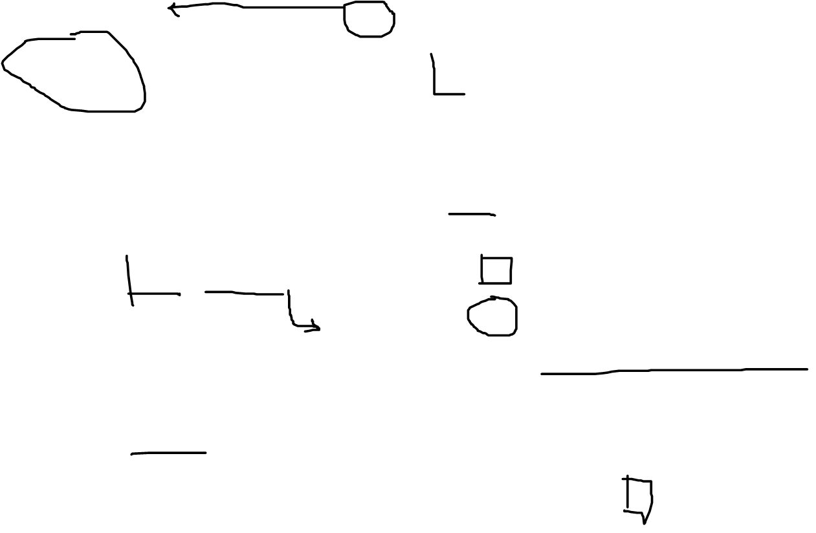
FM sketch
4
3
2
1
0
BITMAP:
Assume a hash function h(x) that maps incoming values x in [0,…, N-1] uniformly across [0,…, 2^{L} -1], where L = O(logN)
x= 3, h(x) =6 →
Let lsb(h(x)) denote the position of the least-significant 1 bit in the binary representation of h(x).
set BITMAP[ lsb(h(x)) ] = 1
0 | 0 | 0 | 0 | 0
4
3
2
1
0
0 | 0 | 1 | 1 | 0
4
3
2
1
0
0 | 0 | 0 | 1 | 0

Slide 12


FM Sketch
Result
Select the position R (0…L-1) of the leftmost 0 in SK
E(R) = log₂ (φ*N) with φ = 0.77351…
R
BITMAP
0 | 1 | 0 | 1 | 1
N=2^{R}/0.7735
Notes:
Proba(SK(0)=1= n/2
Proba(SK

Slide 13
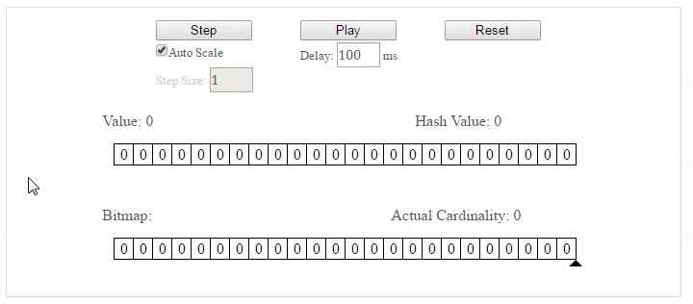
FM sketch
http://content.research.neustar.biz/blog/runs.html

Slide 14

Thank You.

